Slide 1
Chapter : Threads

Slide 2
Chapter : Threads
Overview
Benefits of Threads vs Processes
Single and Multithreaded Processes
Types of Threads
Multithreading Models

Slide 3
Threads
It is single sequential (flow of) execution of tasks of process
A thread (or lightweight process) is a basic unit of CPU utilization; it consists of:
  program counter
  Thread id
  register set
  stack space
A thread shares with its peer threads its:
  code section
  data section
  operating-system resources

Slide 4
Threads (Cont.)
In a multiple threaded task, while one thread is blocked and waiting, a second thread in the same task can run.
  In web browser, one thread displays images, other text, other fetches data from network.
  Word processor, graphics, response to keystrokes, spell check.
  Process = [Code + Data + Heap + Stack + PC + PCB + CPU Registers]
  Thread = [Parent Code, Data and Heap +
  Stack, PC and CPU Registers]

Slide 5
Benefits of Threads vs Processes
Less time to create a new thread than a process, because the newly created thread uses the current process address space.
Less time to terminate a thread
Less time to switch between two threads - newly created thread uses the current process address space.
Less communication overheads - threads share everything: address space, So, data produced by one thread is immediately available to all the other threads.

Slide 6

Single and Multithreaded Processes

Slide 7
Threads States
Three key states: running, ready, blocked
Termination of a process, terminates all threads within the process

Slide 8
Types of Threads
User Level Threads: (ULT)
Threads of user application process.
ULT are supported above the kernel and managed without kernel support
These are implemented in user space in main memory. And managed bu user level library.
The kernel is not aware of the existence of threads
User Level Library is used for – Thread Creation, Scheduling and Management

Slide 9
User Level Threads
Advantages
Thread switching does not require Kernel mode privileges.
User level thread can run on any operating system.
Scheduling can be application specific in the user level thread.
User level threads are fast to create and manage.
Disadvantages
In a typical operating system, most system calls are blocking.
Multithreaded application cannot take advantage of multiprocessing.

Slide 10
Kernel Level Threads(KLT)
Threads of processes defined by OS itself
KLT are supported and managed directly by OS.
Kernel performs Thread Creation, Scheduling and Management in kernel space.
No thread library but system calls to the kernel facility exists.

Slide 11
Kernel Level Threads(KLT)
Kernel level threads are managed by the OS
thread operations (ex. Scheduling) are implemented in the kernel code.
Kernel level threads may favor thread heavy processes.
they can also utilize multiprocessor systems by splitting threads on different processors or cores.
If one thread blocks it does not cause the entire process to block.
KLT are not portable because the implementation is operating system dependent.

Slide 12
Kernel Level Threads(KLT)
Advantages
Kernel can simultaneously schedule multiple threads from the same process on multiple processes.
If one thread in a process is blocked, the Kernel can schedule another thread of the same process.
Kernel routines themselves can be multithreaded.
Disadvantages
Kernel threads are generally slower to create and manage than the user threads.
Transfer of control from one thread to another within the same process requires a mode switch to the Kernel.

Slide 13
Multithreading Models
One-to-One
Many-to-One
Many-to-Many

Slide 14
One-to-One
Each user-level thread maps to one kernel thread
The one-to-one model associates a single user-level thread to a single kernel-level thread.
kernel level threads follow the one to one model
Advantage:
facilitates the running of multiple threads in parallel.
Drawback:
Generation of every new user thread must include the creation of a corresponding kernel thread causing an overhead

Slide 15
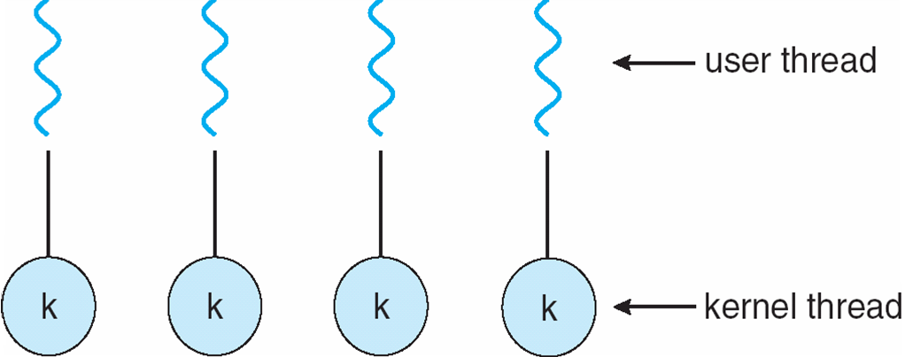
One-to-one Model
The one-to-one model allows for greater concurrency, but the developer has to be careful not to create too many threads within an application

Slide 16
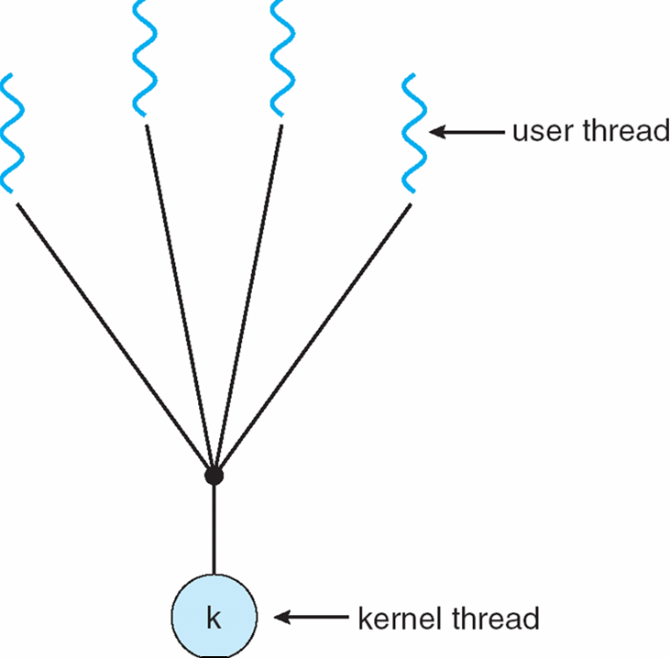
Many-to-One
The many-to-one model associates all user- level threads to a single kernel-level thread.
User level threads follow the many to one threading model.
This means multiple threads managed by a library in user space but the kernel is only aware of a single thread of the process owning these threads.

Slide 17
Many-to-Many Model
In this model, developers can create as many user threads as necessary and the corresponding Kernel threads can run in parallel on a multiprocessor machine.
This model provides the best accuracy on concurrency and when a thread performs a blocking system call, the kernel can schedule another thread for execution.

Slide 18
Many-to-Many Model
A number of user-level threads are associated to an equal or smaller number of kernel-level threads.
Allows many user level threads to be mapped to many kernel threads

Slide 19

Many-to-Many Model

Slide 20
Thread Cancellation
Thread cancellation is the task of terminating a thread before it has completed.
  For example, if multiple threads are concurrently searching through a database and one thread returns the result, the remaining threads might be canceled.

Slide 21
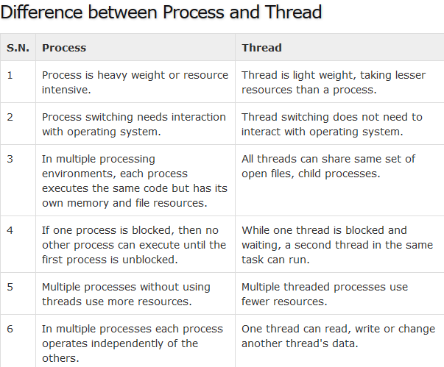

Slide 22
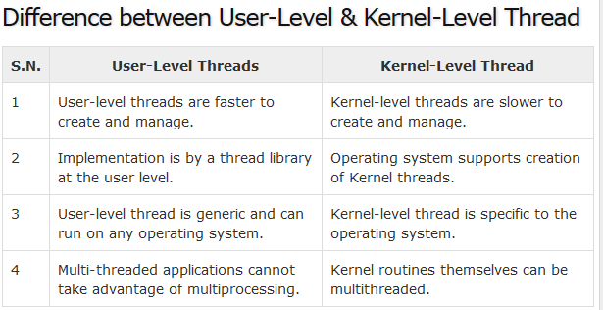

Slide 23
End of Chapter

